Slide 1
MECAL PTY LTD

Slide 2
Mecal Pty Ltd
An Australian owned private Company
Serving industries since 1951
Well known for its:
-Engineering Expertise
-Quality Products
-Capability to customise products to suit
users’ applications
- Excellent after sales services

Slide 3
Summary of Mecal’s Main Products

Slide 4
MECAL VACUUM CLEANING SYSTEMS

Slide 5
Mecal Vacuum Cleaning Systems Features:
Designed and built in Australia since 1980
A complete range of Vacuum Machines for fixed and mobile cleaning systems
Reliable, economical and durable equipment
Proven records through many systems supplied and installed throughout Australia and other countries

Slide 6
Mecal Vacuum Systems Types
Fixed Installation machines and systems from 11 KW to 300KW
Filter Hopper from 10 to 45 square metres filtering area with storage capacity from 0.5 to 3 cubic metres and a variety of discharge types
Portable and movable machines from 22 KW to 300 KW, electrical or diesel powered, container sizes from 1 to 15 cubic metres, trailer or truck mounted

Slide 7
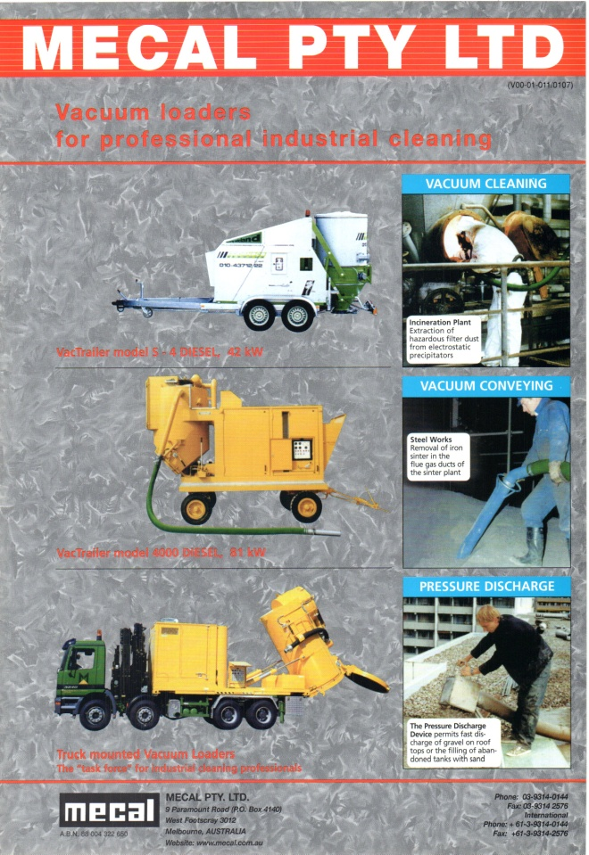
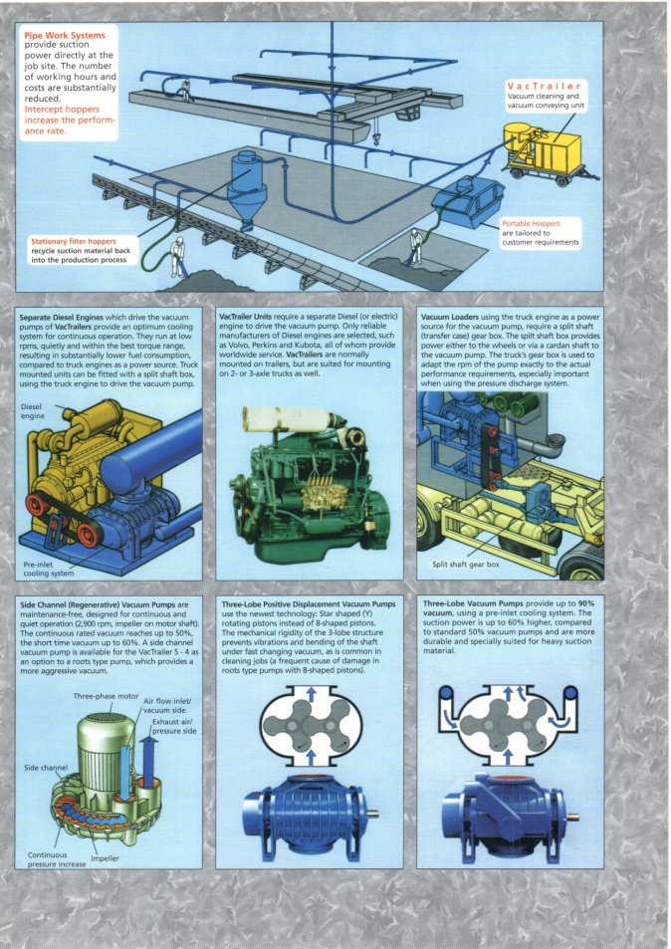
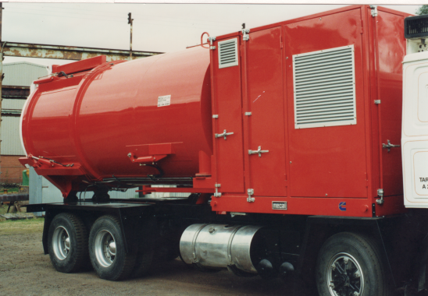
Typical Mecal Vacuum Cleaning Equipment and Systems

Slide 8
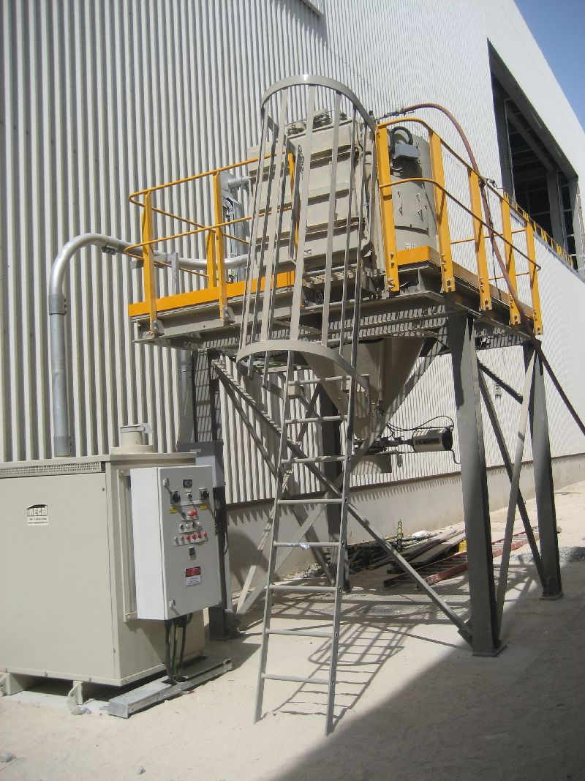
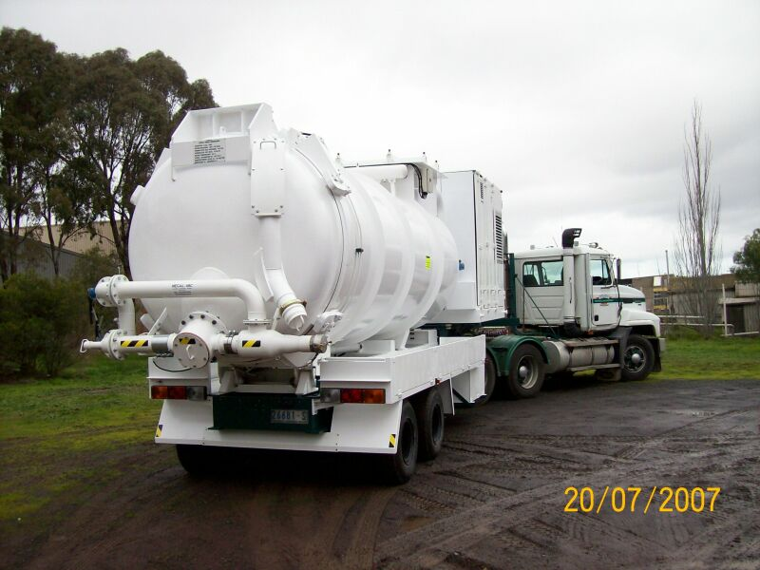
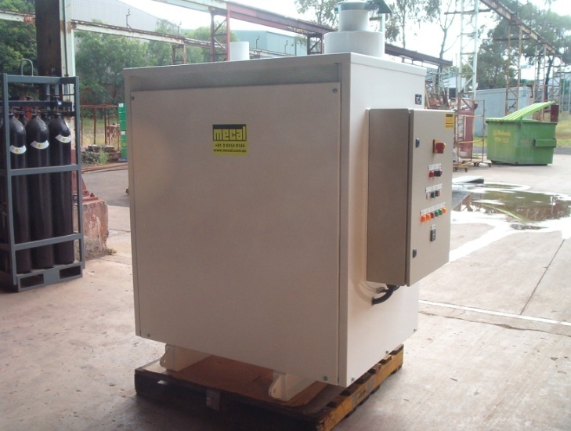
More examples of Mecal Machines and systems

Slide 9
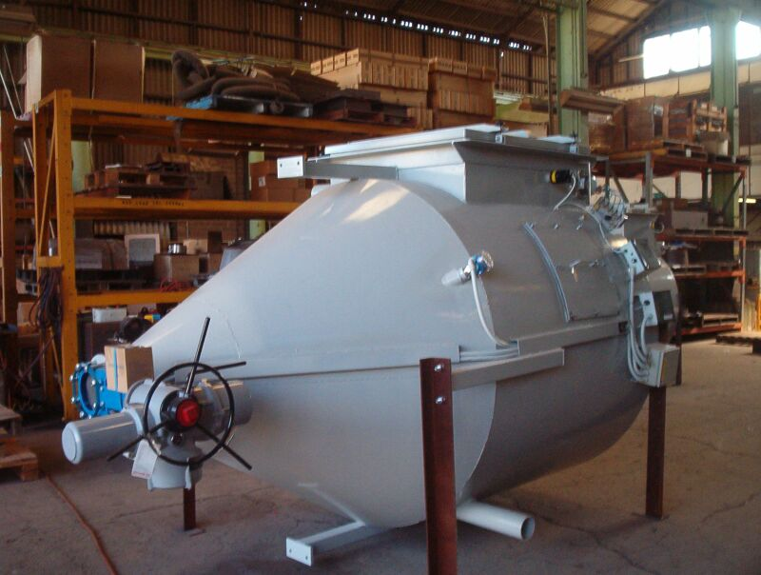
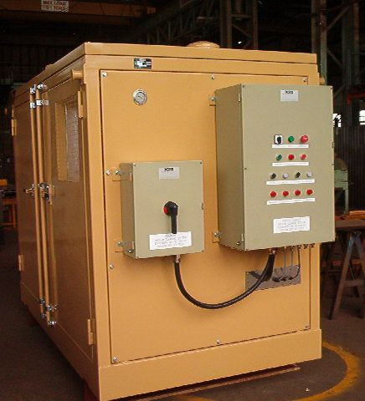
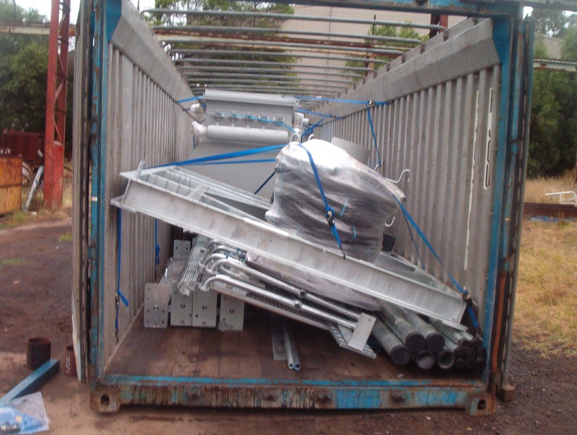
Mecal Systems Ready for Shipment

Slide 10
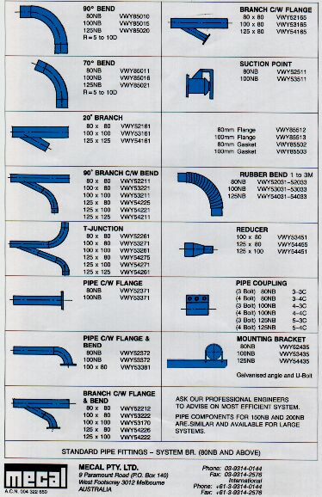
Piping Systems

Slide 11
Hoses and Tools

Slide 12
Advantages of Mecal Vacuum Cleaning Systems
Optimal design for any particular applications
Using a range of standard machines and components then modified to suit clients’ special requirements
Robust and reliable Vacuum Pumps and Filter System to provide Low Maintenance, excellent Reliabilty and Long Service Life
Large range of hoses and tools available
Competitive prices for similar duty requirements

Slide 13
User List of Mecal Vacuum Cleaning Systems

