Slide 1
MECAL MAGNETIC SEPARATORS

Slide 2
Mecal Magnets
A complete range of magnetic Separators and equipment
Designed and manufactured in Australia
‘Computer aided’ selections and designs
Supplied and Installed throughout Australia and many other countries

Slide 3
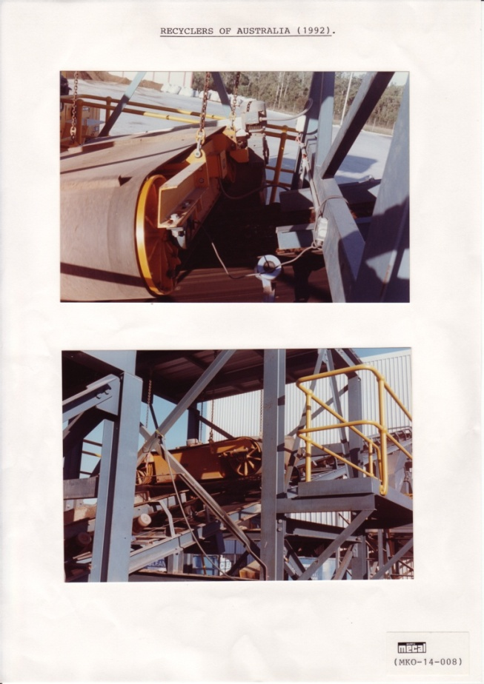
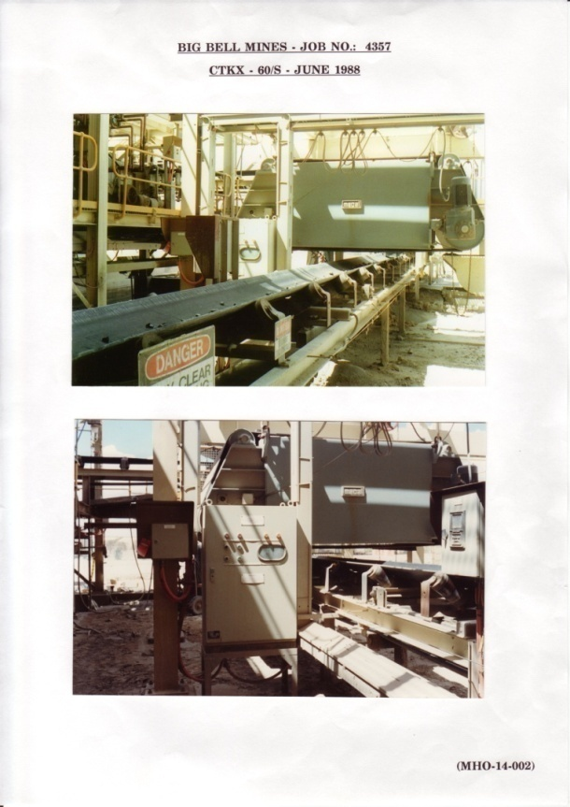
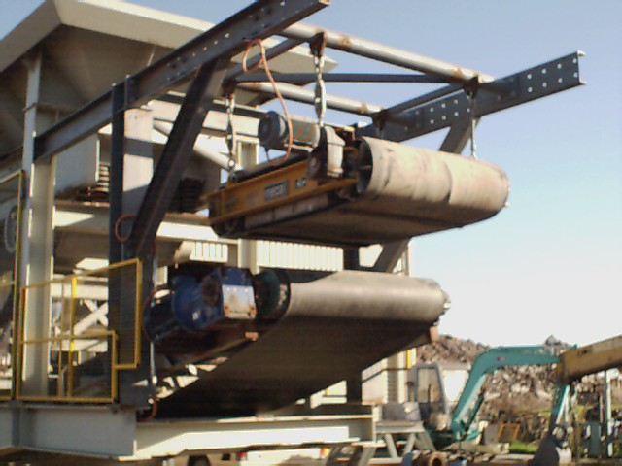
Typical Mecal Magnet Installations
Notes:
3

Slide 4
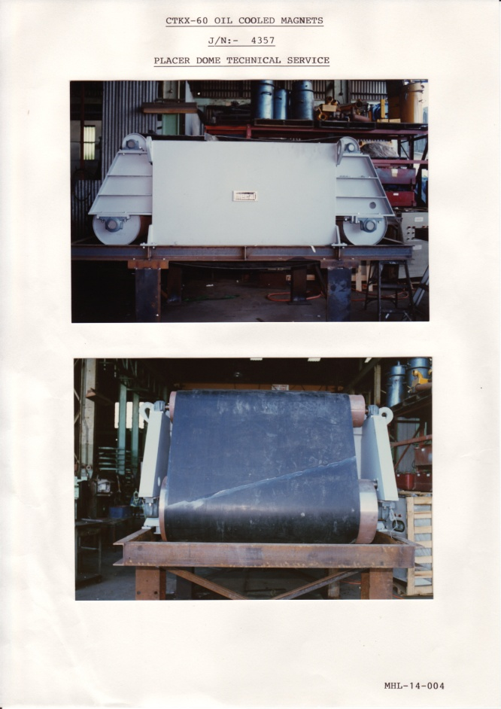
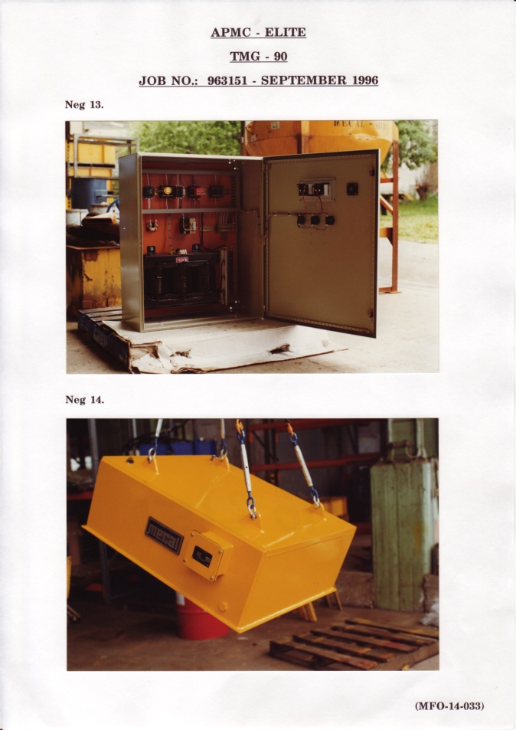
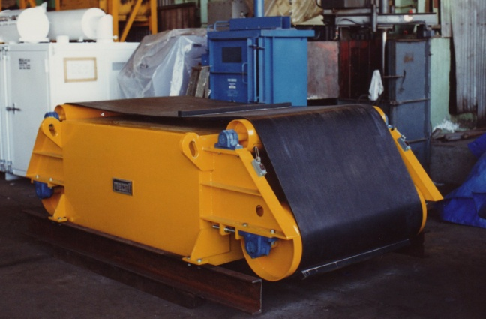
Mecal Magnets Ready for Shipment

Slide 5
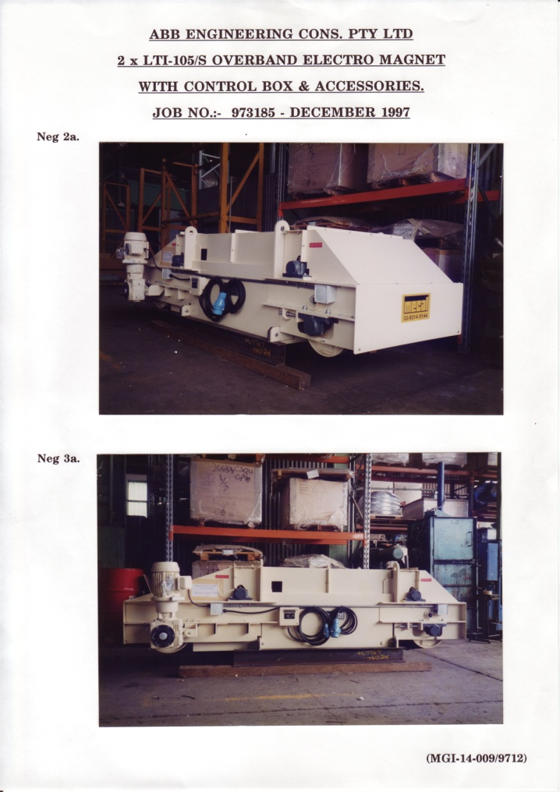
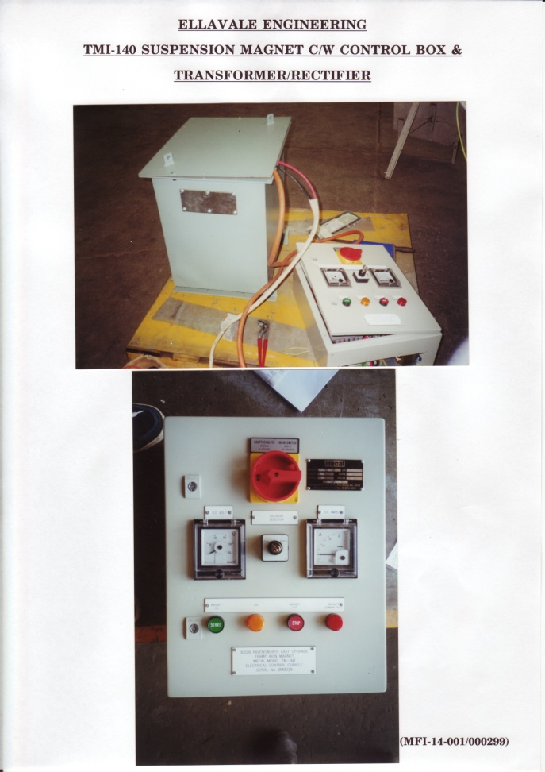
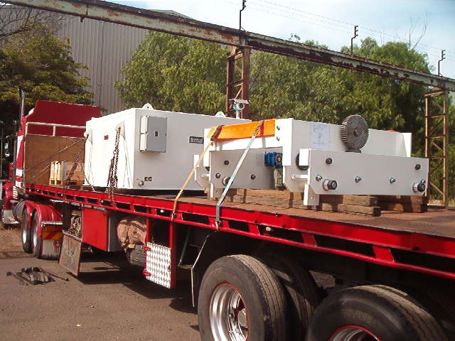
Mecal Magnets Ready for Shipment

Slide 6
Applications of Magnetic Separators
Plant protection and purification
Steel works
Refuse plants
Power stations
Foundries
Mines and quarries
Glass making/recycling
Slag plants
Brick works

Slide 7
Magnetic Separator Types
Permanent Magnet:
(Model KS range, strength from A to E)
Electro Magnet:
(Model TM range, strength from A to M)
Cross belt or Inline installations
Optional self cleaning belt

Slide 8
Magnetic Separator Types
Typical Models as following:
KSE-100: permanent separator, strength
rating E, for 1000 mm belt width, no self
cleaning belt.
TML-100: electro separator, strength rating L,
for 1000 mm belt width, no self cleaning belt.
TMK-140-MC: electro separator, strength
rating K, for 1400 mm belt width, with magna
shield option, no self cleaning belt.

Slide 9
Magnetic Separator Types
CKE-100: permanent separator, strength
rating E, for 1000 mm belt width, cross
belt installation, with self cleaning belt.
LKE-90: permanent separator, strength
rating E, for 900 mm belt width, in line
installation, with self cleaning belt.

Slide 10
Magnetic Separator Types
CTL-120: electro separator, strength
rating L, for 1200 mm belt width, cross
belt installation, with self cleaning belt.
LTM-200: electro separator, strength
rating M, for 2000 mm belt width, in line
installation, with self cleaning belt.

Slide 11
Permanent Magnetic Separators
Suitable for operating gaps up to 350mm and belt widths up to 1400mm
Specifications:
Computer designed magnetic circuit
Poles and back bar fabricated from high permeability steel
Non magnetic stainless steel bottom (bumping) plate

Slide 12
Permanent Magnetic Separators
Performance:
Optimised magnetic extraction power for specific tramp and materials
Able to withstand adverse conditions of vibration, dust, moisture and corrosion
Inherently static in operation
Intrinsically safe in hazardous and underground locations
No operating costs
Low maintenance

Slide 13
Electro Magnetic Separators
Suitable for belt widths from 450mm up to 2200mm
Operating gaps up to 600 mm
Specifications:
Computer designed magnetic circuit
Optimised coil design for minimum weight
Oil cooled
Internal expansion chamber design
Poles and back bar fabricated from high permeability steel
Non magnetic stainless steel bottom (bumping) plate
Terminal box to IP65 standard, higher ratings where required

Slide 14
Electro Magnetic Separators
Performance:
Optimised magnetic extraction power for specific tramp and materials
Able to withstand adverse conditions of vibration, dust, moisture and corrosion
Standard Ancillaries:
Suspension chains
Magnet DC Power Supply via Transformer Box
Electrical Control Box IP65 standard, higher rating where required
Notes:
Optional Ancilliaries
14

Slide 15
Electro Magnetic Separators
Optional Ancilliaries:
Magna shield to retain the tramps when power supply is cut off
Manual or motorised trolleys for moving the magnet to dumping station
Automatic self cleaning belt

Slide 16
Advantages of Mecal Electro Magnetic Separators
Internal expansion chambre for cooling oil with special design check valve so that no cumbersome separate expansion tank
Designed with optimum magnetic power resulting low ratio of weight/magnetic power
Having best Force Index Value for each magnet
Robust magnet casing and stainless steel bottom bumping plate
Excellent Reliability and Service Life
Competitive prices for similar duty requirement

Slide 17
User List of Mecal Magnets

Slide 18
User List of Mecal Magnets

Slide 19
User List of Mecal Magnets

Slide 20
User List of Mecal Magnets
Latest Electro Magnets Supplied by Mecal:
Company/Country Location State Type Industry Product/Year
AUSTRALIA.
Laing O’Rourke Abbott Point QLD TMM-220/MC Coal Terminal Coal/ 2009
Quarry/Mining Bendigo VIC 2 x TMH-120 Mining Quarry/ 2008
Roberts & Schaffer Blackwater QLD TMH-140/MC Mining Coal/ 2006 TMKX-180/MC
TML-180/MC
Barclay Mowlem Curragh North QLD TML-200/MC Mining Coal/ 2007
TMJ-160/MC
Idemitsu Boggabri QLD TMKX-160/MC Mining Coal/ 2006
Nepean Conveyor Grasstree QLD TML-180/MC Mining `Coal/ 2006
AGL Coal Muswellbrook NSW LTL-200 Mining Coal/ 2006

Slide 21
User List of Mecal Magnets
INDONESIA.
PT Bukaka Teknik Bukit Asam TML-200/MC Contractor Coal/ 2006
JMC TML-180/MC Contractor Coal/ 2006
PT Pekas East Kalimantan LTJ-160 Contractor Coal/ 2007
PT Wahana East Kalimantan LTJ-160 Contractor Coal/ 2007
NEW ZEALAND.
NZ Aluminium Smelter Bluff CTL-160/S Alum. Smelter Alum. / 2009
SINGAPORE.
AE Automation TMJ-140/MC Contractor Coal/ 2007

